Slide 1
NF Collab Update – Proposed Figures
07/12/2023

Slide 2
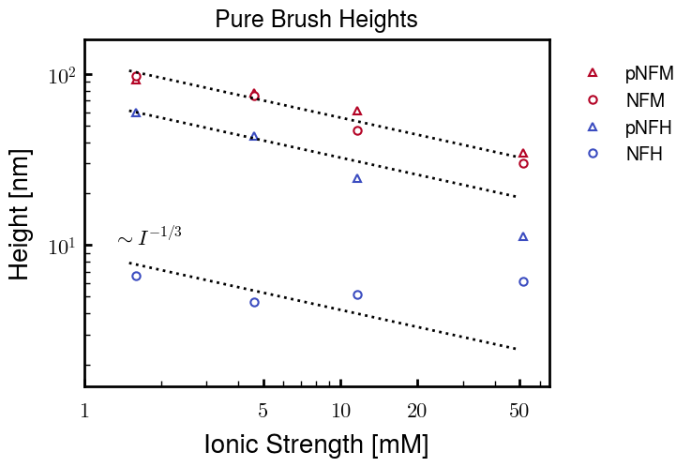
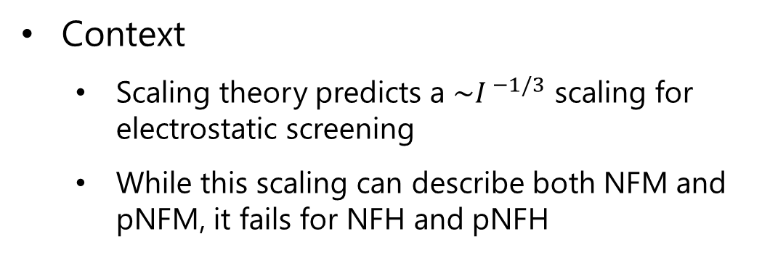
Research Question
How do the chemical identities of NFH and NFM determine their function within NFs?
Context
Scaling theory predicts a ${\sim I}^{ −1/3}$ scaling for electrostatic screening
While this scaling can describe both NFM and pNFM, it fails for NFH and pNFH

Slide 3
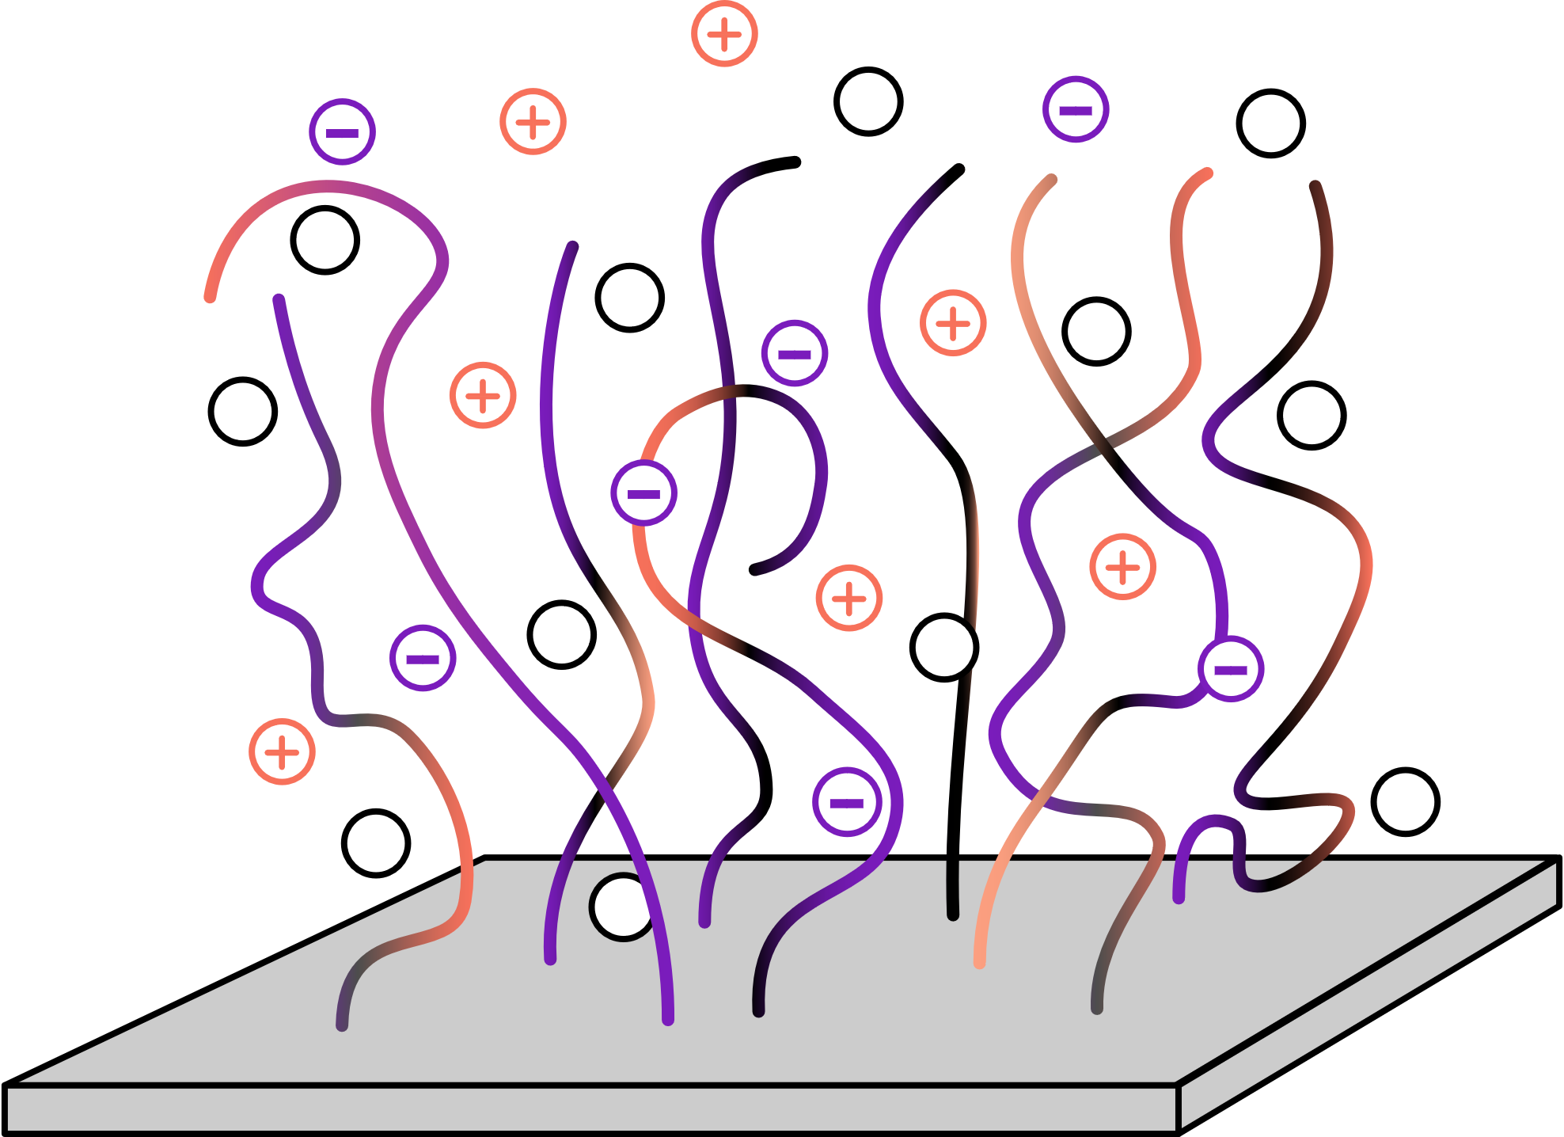
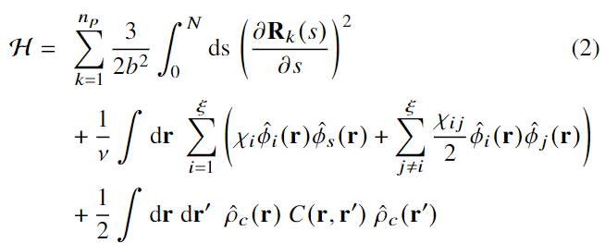
Model
Solvent
System:
Protein amino acid sequence
Solution salt concentration and pH
Charge calculated using bulk pH
Protein
Ions
Elastic energy
2-body Flory-Huggins
Electrostatics

Slide 4
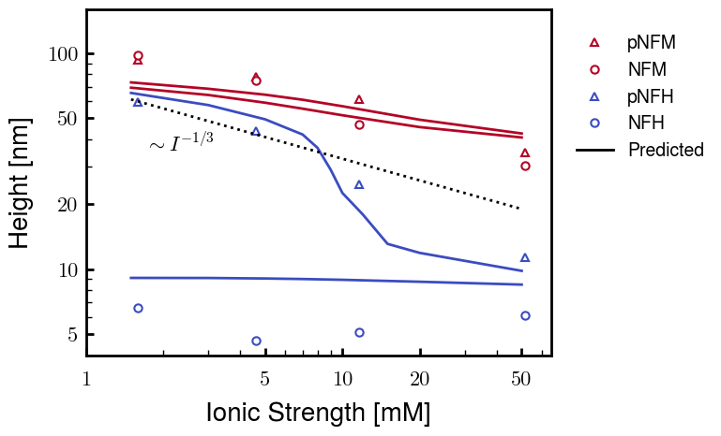
Proposed Figure 1

Slide 5
SI Table of Contents

Slide 6
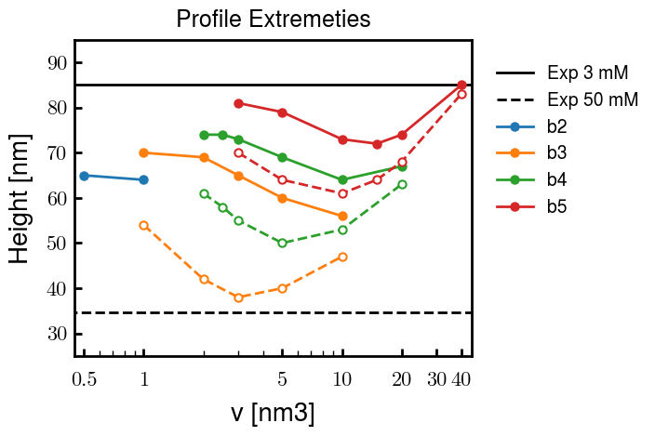
pNFM Fitting (b/v)

